Slide 1
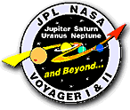
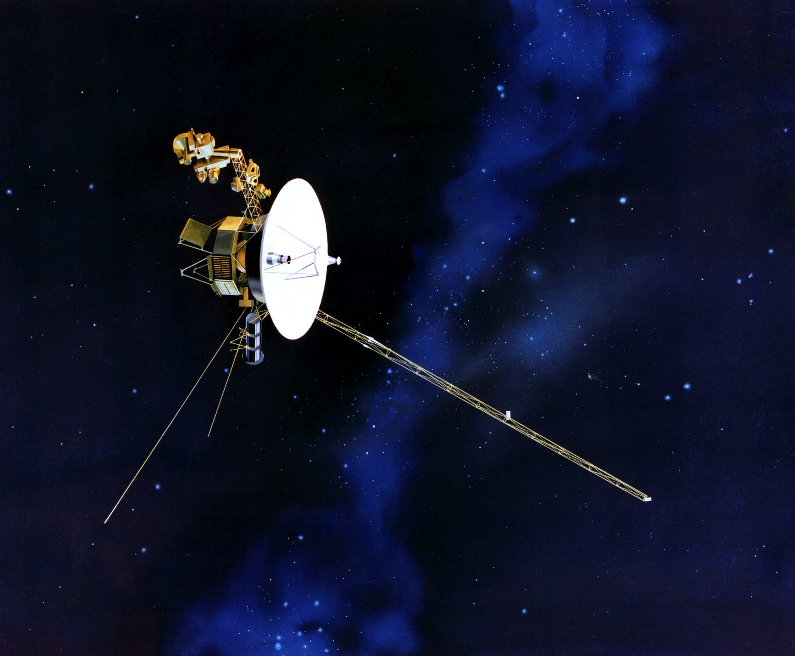



Voyager and the Heliosphere
Dave Falkner
Aurora Summit
November 5, 2022
Notes:
Or “What happens to the solar wind after it passes by Earth?”
Talk about who you are and the SSAP

Slide 2
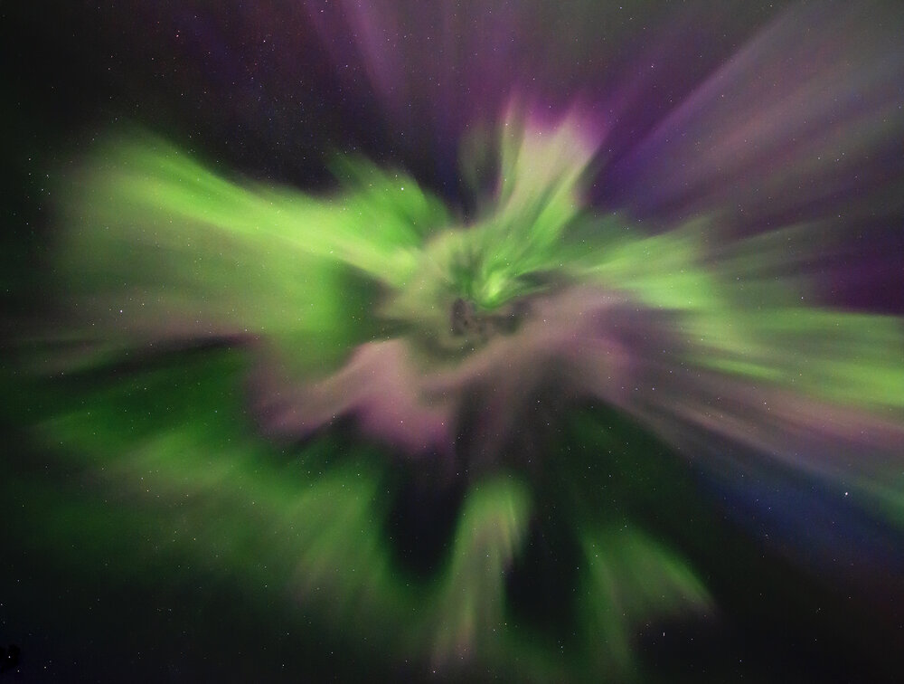
Northern Lights
Credit: Mike Shaw Photography
Notes:
We all know that the Northern Lights are caused by the interaction of:
The Solar Wind
The Earth’s Magnetic Field
Upper atmosphere
The Solar Wind doesn’t stop at Earth – What happens after it passes our region of the Solar System?
2 iconic spacecraft named Voyager 1 & 2 helped answer questions astronomers had – and had a couple of surprises!

Slide 3
Presentation
The Voyager Program
The Voyager Interstellar Mission (VIM) – Exploring the Heliosphere and Beyond
Where they are today and Where They are Going
Notes:
VIM – where we learn what happens to the solar wind.

Slide 4
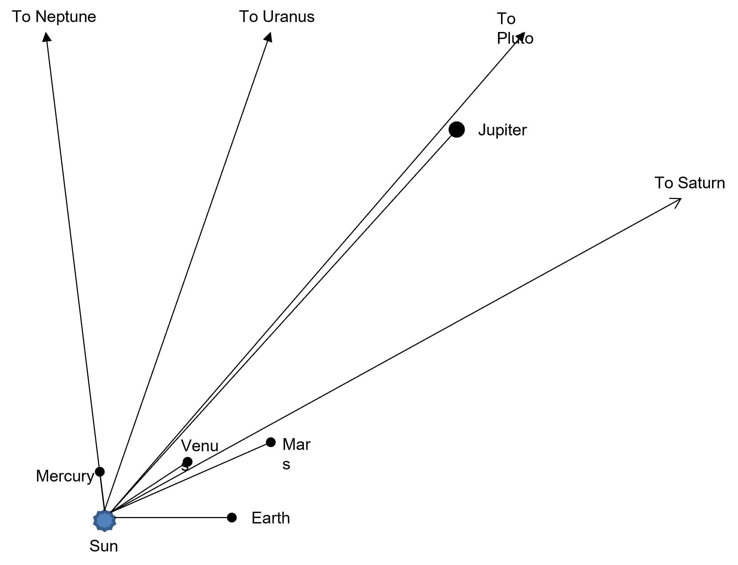
Syzygy
The Reason for Voyager
Notes:
Syzygy – In Astronomy, the alignment of three celestial bodies, such as the Sun, Earth and Moon at Full Moon.
In 1982 this definition was extended to mean that all nine planets were located on the same side of the Sun, and within a 95-degree interval.
It is a planetary alignment than only occurs every 175 years.
In 1964 NASA realized this rare alignment of the planets would occur in the late 1970’s and early 1980’s
The Planetary Grand Tour
This alignment of Jupiter, Saturn, Uranus and Neptune allows a spacecraft to swing from one planet to the next using gravity assist without the need for large, on-board propulsion systems.

Slide 5
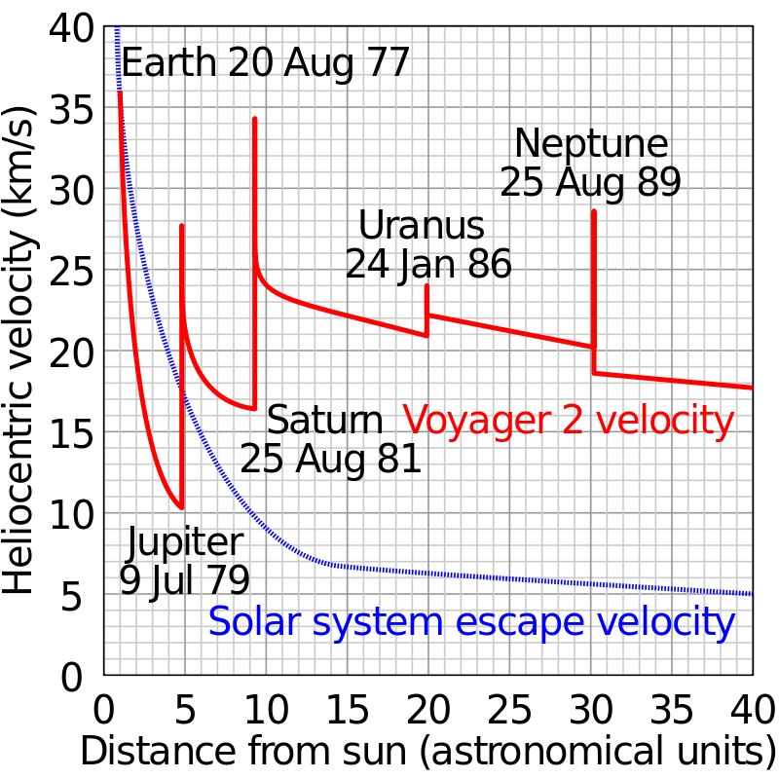
The Gravity Assist Effect
Notes:
The flyby of each planet bends the spacecraft’s flight path and accelerates it enough to reach the next planet. By using this technique, the flight time to Neptune was reduced from 30 years to 12.
This was the plan
Budget cuts reduced the mission to just Jupiter & Saturn in 5 years

Slide 6
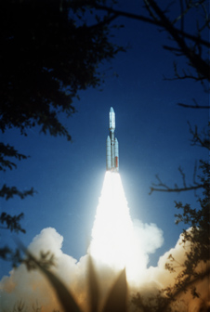
Voyager
Launches
Voyager 2 was launched on August 20, 1977
Voyager 1 was launched on September 5, 1977, on a shorter, faster trajectory
The original five-year mission was a Jupiter and Saturn flyby
Notes:
Voyager 2 launched August 20, 1977
Voyager 1 launched September 5, 1977
Voyager 1 passed Voyager 2 on September 8, 1978 (about a year later)

Slide 7
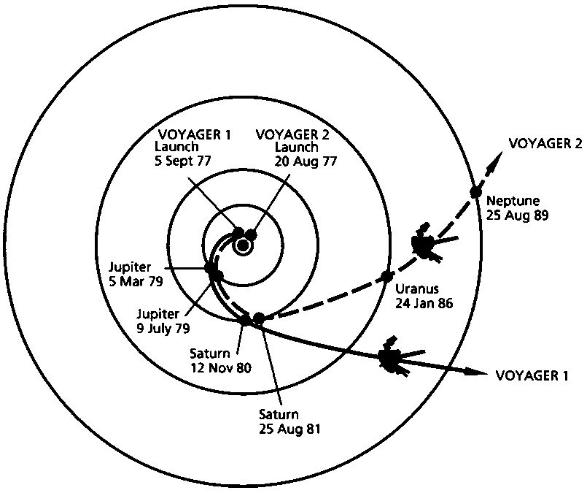
The Planetary Grand Tour
By using gravity assist the Voyager spacecraft could visit the outer planets in record time
Notes:
Planetary Grand Tour was conceived to use this rare alignment of the outer planets
By launching spacecraft in the late 1970’s the four gas giants and Pluto could be visited using a minimum of propellant and trip time.

Slide 8
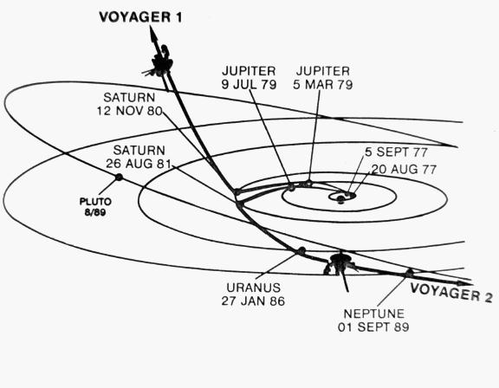
New Trajectories
Notes:
After their successful planetary investigations their missions were extended to include an interstellar mission
Voyager 1 trajectory is 35° north of the ecliptic at 3.6 AU per year
Voyager 2 trajectory is 48° south of the ecliptic at 3.3 AU per year

Slide 9
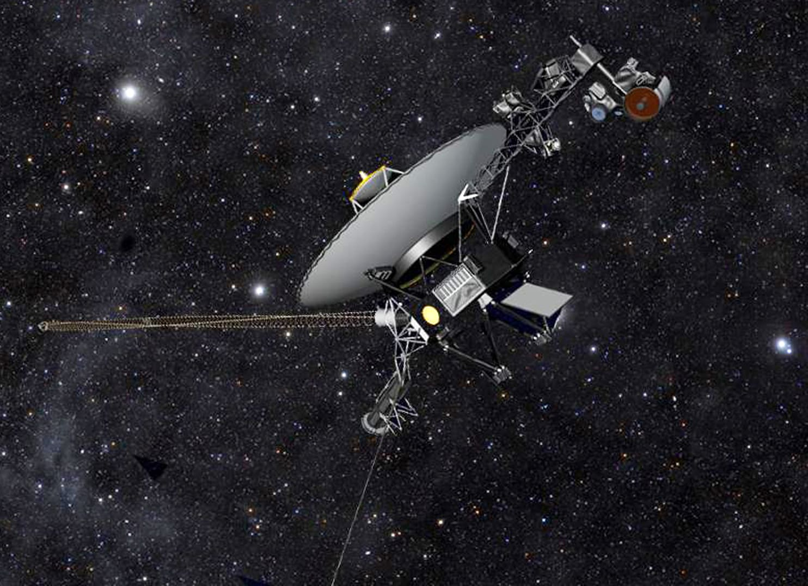
Voyager Interstellar Mission
Notes:
With the successful flybys of the gas giant planets, and more importantly (and amazingly) both spacecraft were still fully operational, NASA decided to add an Interstellar Mission.
Both Voyager spacecraft were now heading for the edge of the solar system at 35,000 miles per hour. But it would be 15 years before they began to detect edge of the solar system, that is, the part of space dominated by the solar wind.
On February 17, 1998 Voyager 1 passed Pioneer 10 and became the most distant human-made object in space.
Let’s talk about the detectors being used for the interstellar mission

Slide 10
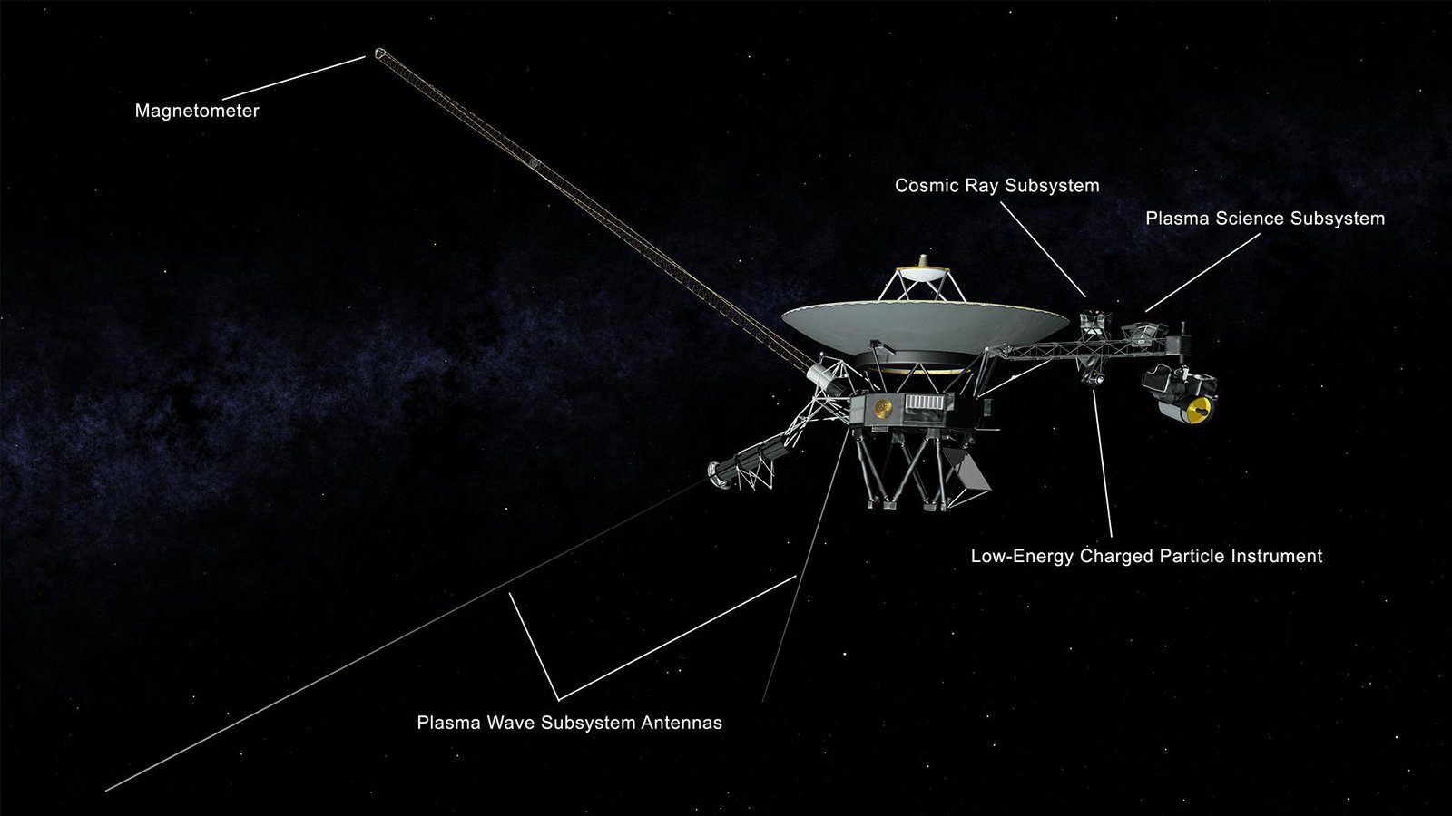
Interstellar Detectors
Notes:
Triaxial Fluxgate Magnetometer (MAG) - Will measure the interplanetary magnetic field out to the solar wind boundary with the interstellar magnetic field and beyond, if crossed
Plasma Science (PSLS) - It determines the flow speed and direction, density, and temperature of the plasma.
Cosmic Ray System (CRS) - Determines the origin and acceleration process, life history, and dynamic contribution of interstellar cosmic rays
Low Energy Charged Particle (LECP) Instrument - Looks for particles of higher energy than the PLS, and it overlaps with the Cosmic Ray Subsystem (CRS). It has the broadest energy range of the three sets of particle sensors. (Wood analogy)

Slide 11
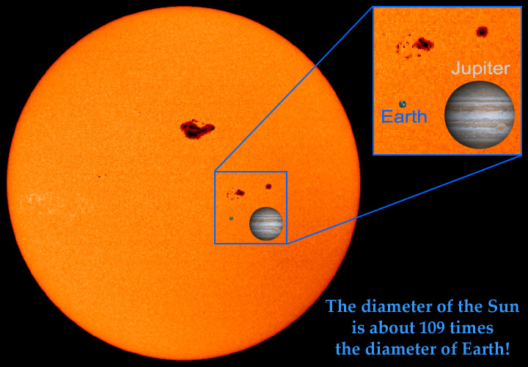
Some Facts
Closest star and center of the solar system
Diameter: 1,390,000 km
Notes:
Before we discuss Voyager’s discoveries about the heliosphere we need to know a couple of things about The Sun
The Sun is huge
It is composed of plasma – not solid
This produces a large dynamo effect resulting in a huge magnetic field

Slide 12
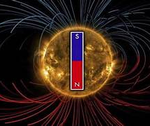
Sun’s Primary Magnetic Field
Has a North & South Pole
Extends well beyond the planets
Flips its polarity every 11 years along with the sunspot cycle

Slide 13
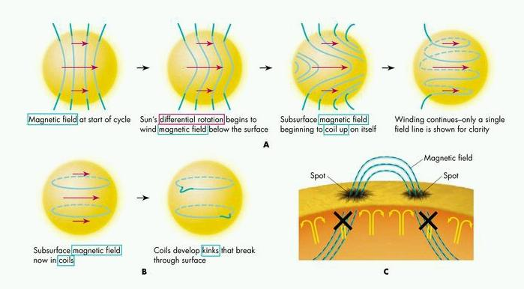

Slide 14
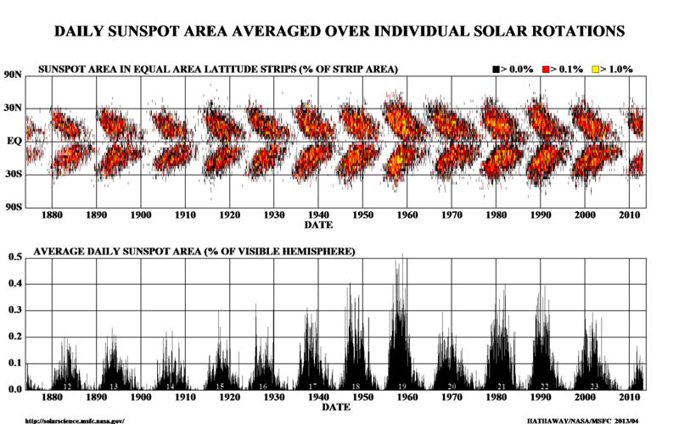
Sunspot Butterfly Graph
Notes:
Sunspot cycle will peak in 2025

Slide 15
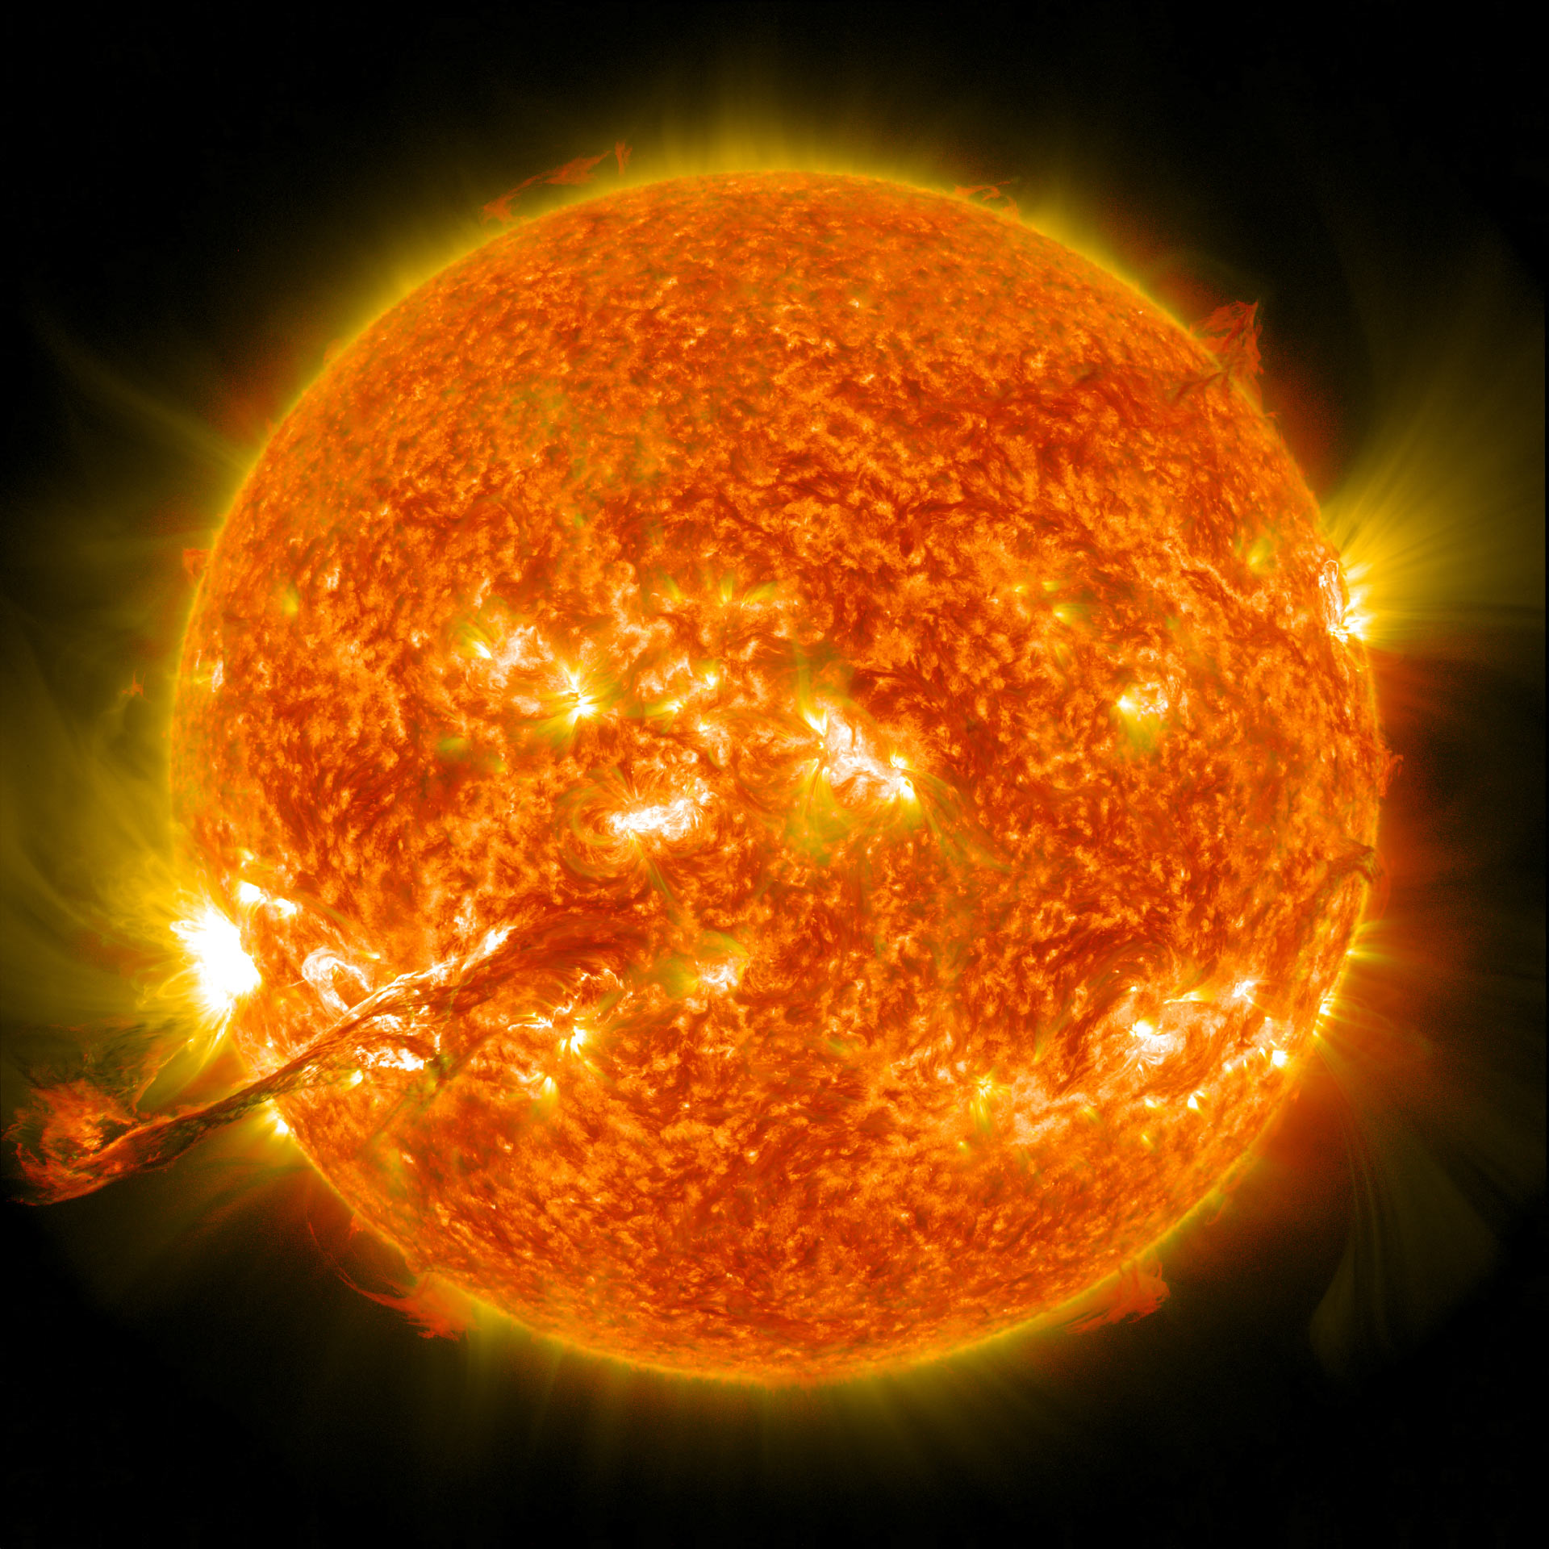
Notes:
There is a constant flow of plasma (electrons and ions) from the Sun’s surface into space moving at about a million miles per hour (supersonic)
Prominences and a Coronal Mass Ejection result in increased density in the solar wind
Takes about 3 days to reach the Earth
A hit by a CME will result in massive aurora and even electrical disruption
Carrington Event of September1859 – Richard Carrington – amateur – witnessed the solar flare and put 2 and 2 together
Province of Quebec blackout – March 1989
Solar explosion witness on March 10
On March 12 it hit the Earth’s magnetic field causing aurora as far south as Florida & Cuba
Within 2 minutes the entire electrical grid in Quebec was knocked out for 12 hours

Slide 16
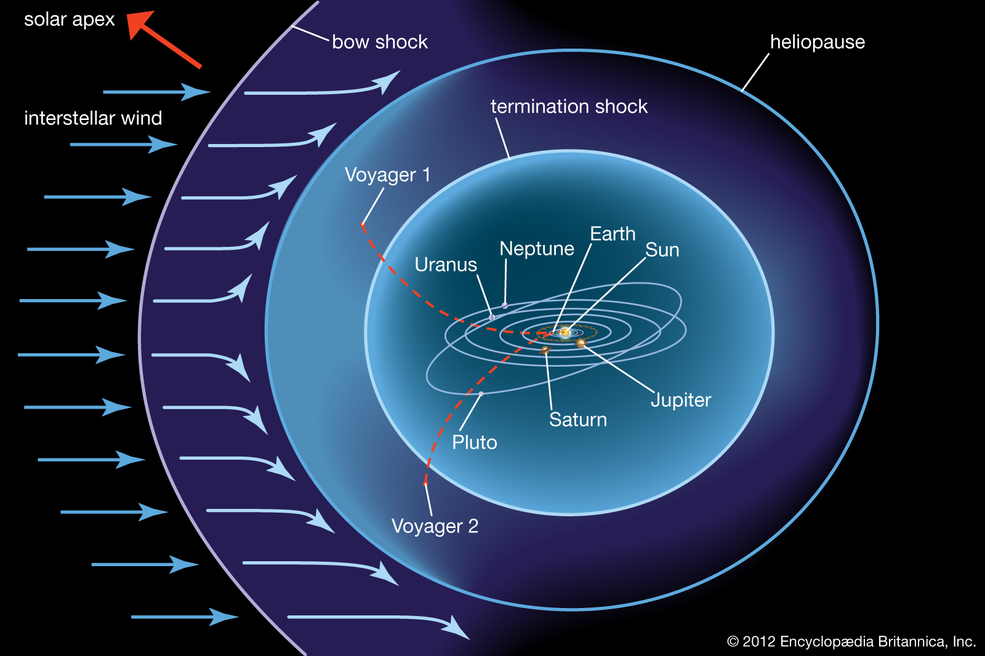
What Theory Predicted
Based on information from IBEX
Terminal Shock
Subsonic Heliosphere
Heliopause
Interstellar space
Notes:
At this point we need to talk about what NASA expected to happen when Voyager ventured beyond the planets
Interstellar Boundary Explorer (IBEX) – remotely explored the edge of the Heliosphere
As the spacecraft reached the termination shock the solar wind would drop from supersonic speeds to subsonic speeds
Supersonic speeds start at about 770 miles/hr
It would continue to pass through the heliosphere to the heliopause
As they pass through the Heliopause, approximately 100 AU from the Sun, the solar radiation will drop off and cosmic radiation will increase.
They also expected to see a shift in the magnetic field.

Slide 17
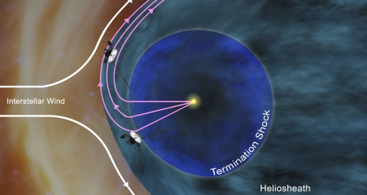
Change in Magnetic Field
Notes:
As we will discover the change in magnetic field is rather critical.
When the spacecraft passes through the region of the heliopause, about 11 billion miles out, the prevailing direction of the local magnetic field will shift as it moves beyond the influence of the Sun and is directed by the intergalactic particles. (look more into this)

Slide 18
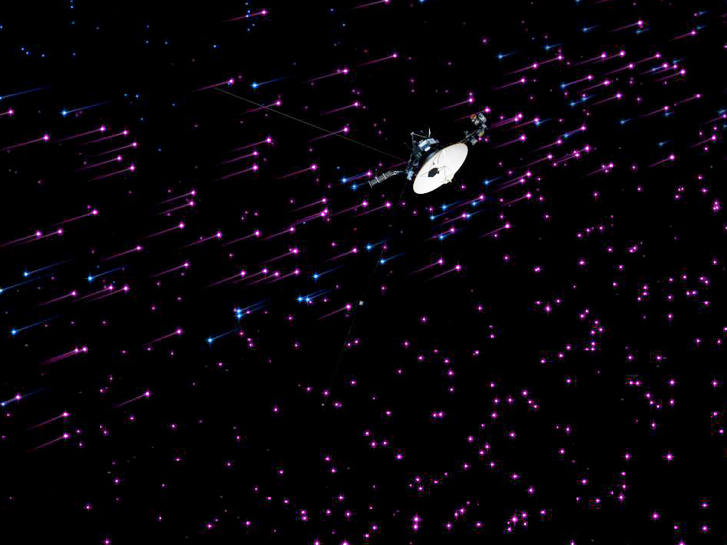
The Magnetic Highway
Notes:
NASA has dubbed this region of space the “Magnetic Highway”
In this region, the sun's magnetic field lines are connected to interstellar magnetic field lines, allowing particles from inside the heliosphere to zip away and particles from interstellar space to zoom in.
Voyager’s Triaxial Fluxgate Magnetometer (MAG) should be able to detect this transition.
Once Voyager passed through this region NASA expects the magnetic lines to shift

Slide 19
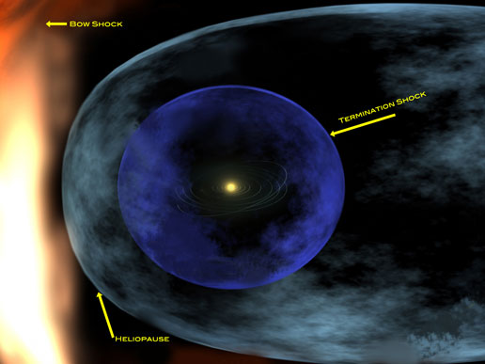
Three Phases of the VIM
Heliosheath
The Termination Shock
Heliosheath Exploration
Interstellar Exploration
Heliosheath
Heliosheath
Notes:
The Voyager Interstellar Mission can be divided up into three phases.
The Termination Shock
Heliosheath Exploration
Interstellar Exploration
In 2004 Voyager 1 crossed the Termination Shock as indicated by the Solar Wind speed and began its exploration of the Heliosheath
The solar wind is slowed by the counter effects of the Interstellar wind
At some point this slows the solar wind below supersonic levels
At 94 AU or 8.7 billion miles
We’ll talk about Voyager 1 but Voyager encountered similar effects a few years later
V1 & V2 crossed the Heliopause at different times and in different regions
The distance from the Sun varied between the two indicating that the size of the heliosphere expands and contracts with solar activity

Slide 20
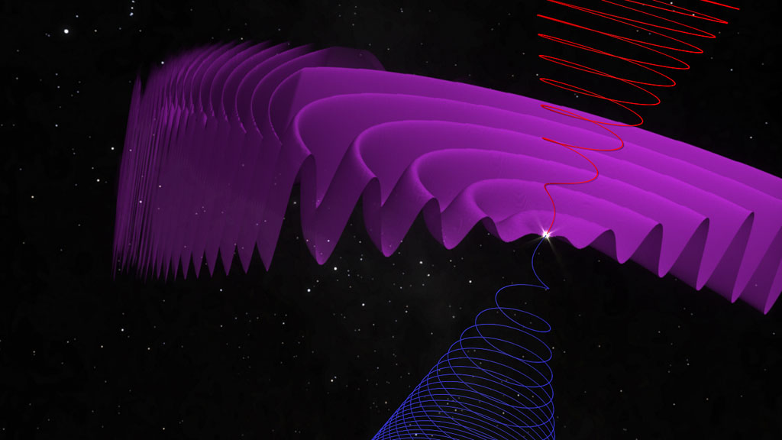
Magnetic Wave Compression
Notes:
As Voyager approached the heliopause region of space it started encountering a more intense magnetic field
In this part of the Heliosheath Voyage started sending back very strange readings
Scientists believe the North and South magnetic field emanating from the Sun sets up magnetic waves
As these magnetic waves approach the Heliopause boundary they reflect off, crisscross, and recombine in an unusual way

Slide 21
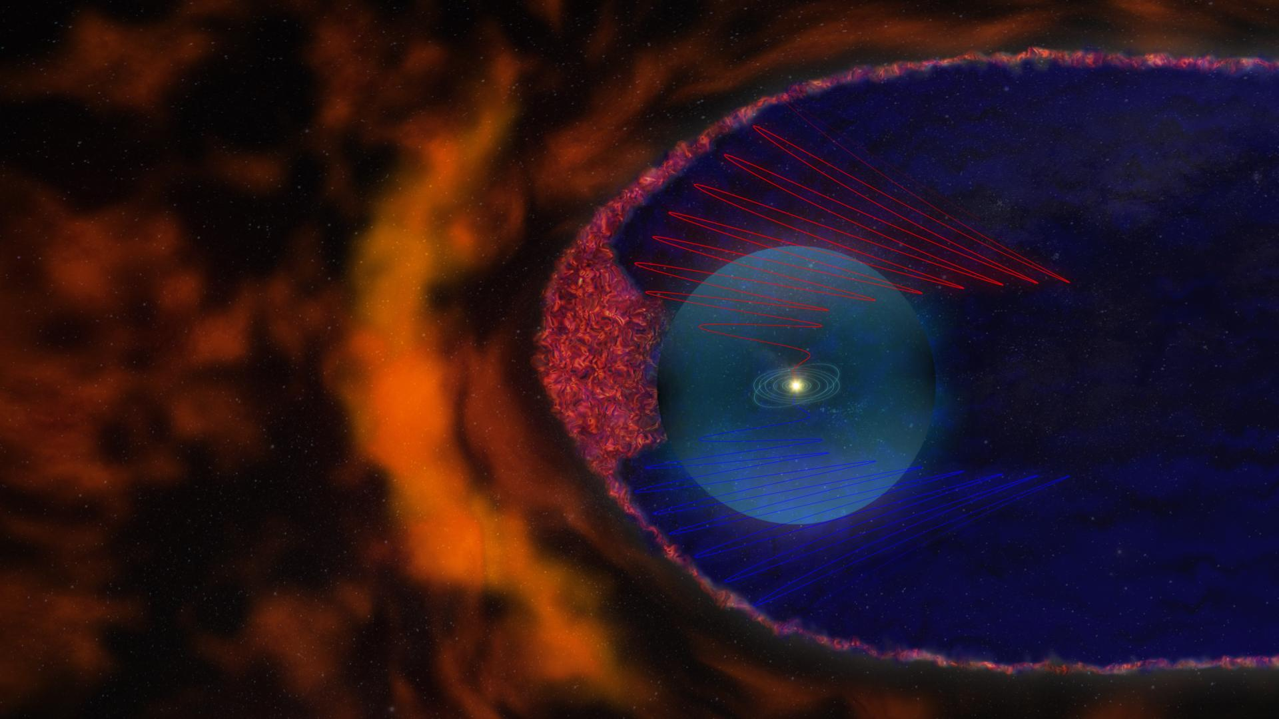
Notes:
First Surprise
In 2007 Voyager 1 entered this area of the Heliosheath and a year later Voyager 2 began sending similar information.
After analyzing the data NASA scientists determined that this was an area of magnetic bubbles closely packed together in a froth.
<LEAVE>
<AFTER RETURNING>
NASA has since determined that some of the interstellar cosmic rays seem to bounce around as they penetrate the froth getting trapped in the magnetic froth
This partially shields the solar system from cosmic rays

Slide 22
Notes:
Going back to this view
The Solar Apex is the direction the Sun is moving in the local are of the galaxy
Think of a ship moving through the interstellar medium
The stellar wind piles up at the bow (called the box shock) and is less intense as it moves around the “hull”
Voyager 1 is exiting more toward the “bow”
Voyager 2 is exiting more at the flank

Slide 23
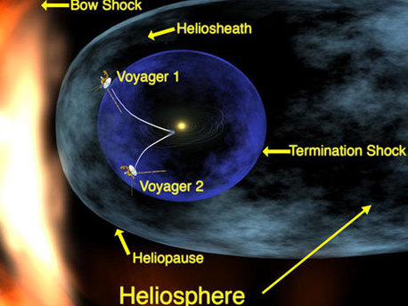
Leaking
Particles
Bow Shock
Voyager 2 exited more on the flank
This area appears more porous
Voyager 2 is detecting “leaking” solar wind particles slipping through the boundary into interstellar space
Notes:
One of Voyager's particle instruments showed that a trickle of particles from inside the heliosphere is slipping through the boundary and into interstellar space.
Voyager 1 exited close to the very "front" of the heliosphere, relative to the bubble's movement through space.
Voyager 2, on the other hand, is located closer to the flank, and this region appears to be more porous than the region where Voyager 1 is located.

Slide 24
Three Interstellar Indicators
To review – NASA was looking for three primary indicators that Voyager had passed out of the Solar System and into interstellar space
The reduction and eventual elimination of Solar radiation particles (i.e., Solar Wind)
A marked increase in Cosmic radiation
A change in the local magnetic field resulting from moving from the influence of the Sun and largely directed by galactic particles.

Slide 25
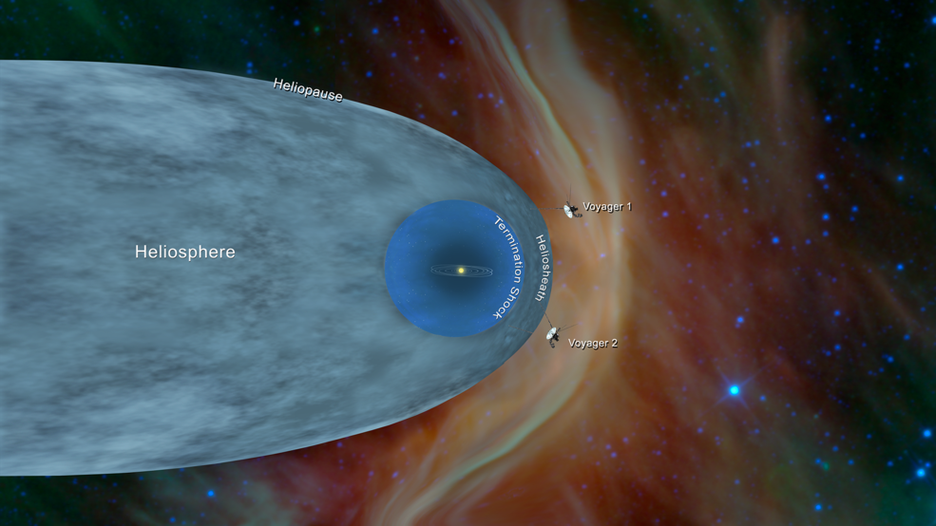
Passing through the Heliopause
Notes:
Finally there were positive indications the Voyager spacecraft were entering interstellar space
Voyager 1 passed through the Heliopause in 2012 (121 AU)
Voyager 2 passed through the Heliopause in 2018 (118 AU)

Slide 26
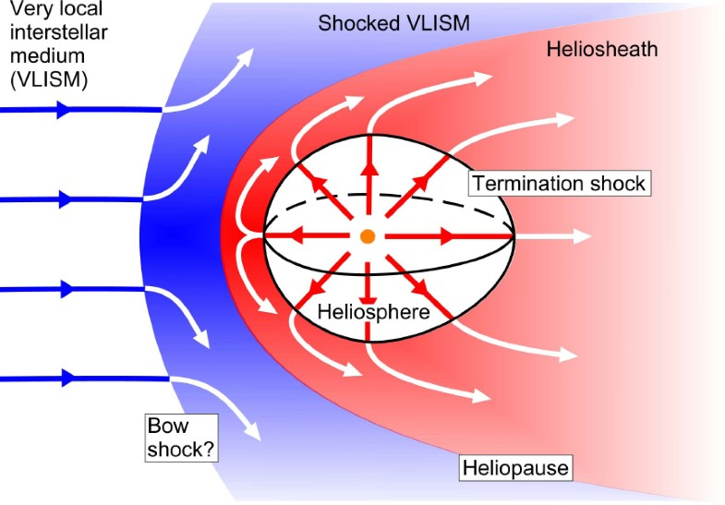
Notes:
Recall that NASA scientists expected a change in the magnetic field as the Voyager spacecraft moved from the heliosphere into interstellar space
However, Magnetometer readings from both Voyager 1 and 2 confirmed that the magnetic fields aligned.
This was unexpected.

Slide 27
Where are Voyager 1 & 2 Today
Status as of October 17, 2022
Voyager 1
14.7 billion miles from Earth (158 AU)
1-way transmission time is 21.5 hours
Instruments still operational
  Cosmic Ray Subsystem (CRS)
  Low Energy Charged Particle (LECP)
  Magnetometer (MAG)
  Plasma Wave System (PWS)
Voyager 2
12.2 billion miles from Earth (131 AU)
1-way transmission time – 18.25 hours
Instruments still operational
  Cosmic Ray Subsystem (CRS)
  Low Energy Charged Particle (LECP)
  Magnetometer (MAG)
  Plasma Wave System (PWS)
  Plasma Science (PLS)
In addition, both spacecraft have an operational RTG and two-way radio communications
Notes:
Both spacecraft also have adequate electrical power and attitude control propellant to continue operating until around 2025, after which there may not be electrical power to support science instrument operation; science data return and spacecraft operations will cease.

Slide 28
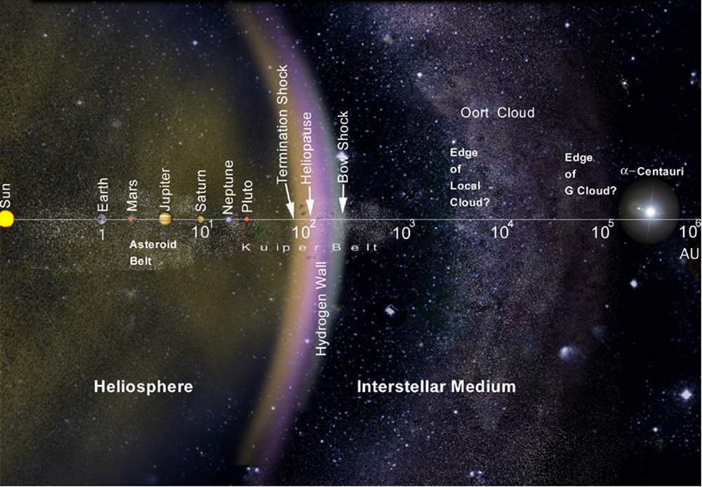
Where are they going?
Notes:
Although V1 and V2 have left the heliosphere they have not left the Solar system
The boundary of the solar system is considered to be beyond the outer edge of the Oort Cloud, a collection of small objects that are still under the influence of the Sun's gravity
Starts at 1000 AU (300 years) and extends to 100,000 AU (30,000 years)

Slide 29
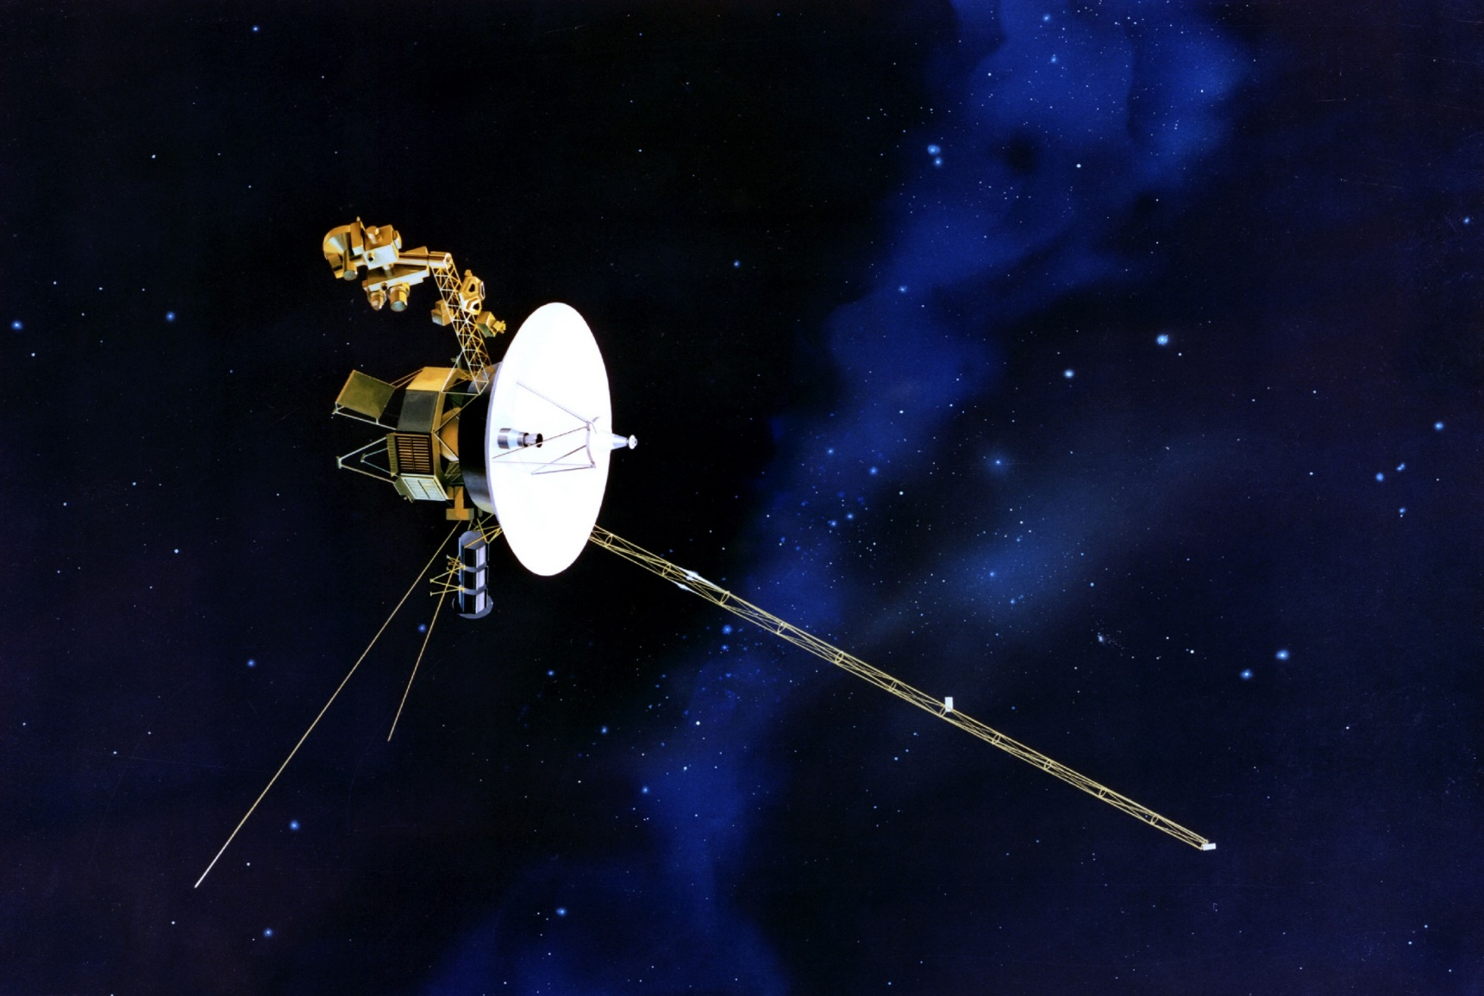
Where to Next?
Notes:
See next 2 slides

Slide 30
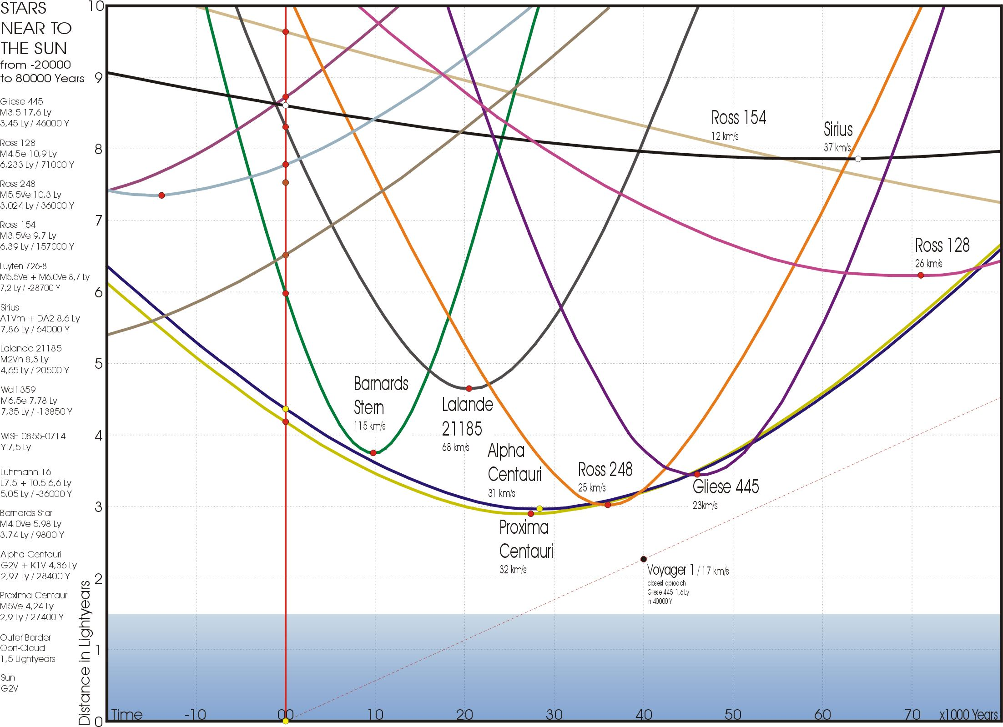
Voyager 1
Notes:
In about 46,000 years, Voyager 1 will be within 3.5 light years (ly) of as star known as Gliese 445

Slide 31
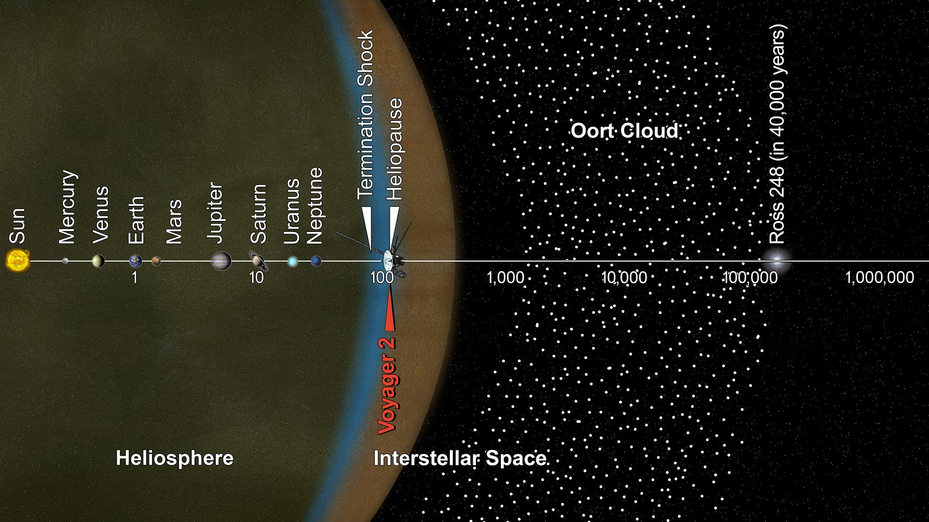
Notes:
In 40,000 years Voyager 2 will be within 1.7 ly of Ross 248 and in 296,000 years it will pass within 4.6 ly of Sirius which is the brightest star in the night sky.

Slide 32
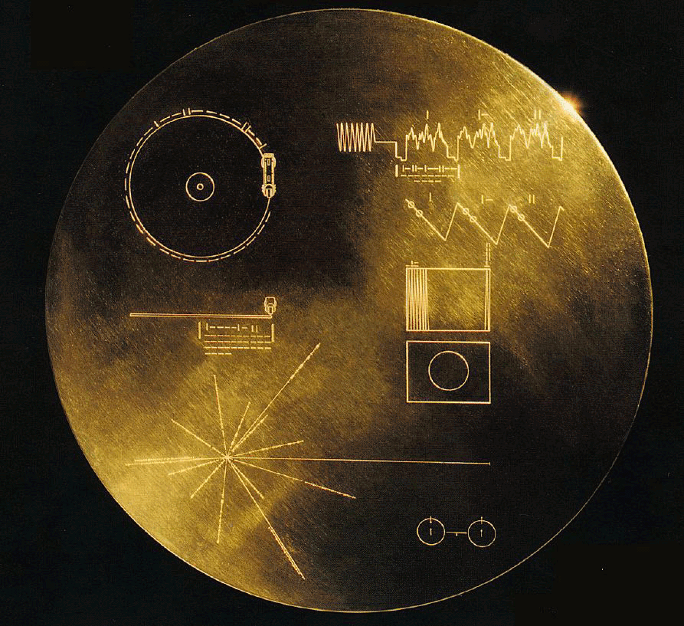
Image of Golden Record Jacket
Notes:
Carl Sagan - SETI
Both Voyager spacecraft are carrying a golden record in the event they are intercepted by an intelligent species.
Each record is encased in a protective aluminum jacket (shown here)
Shows the image of the record and how it is to be played with binary information on the speed of revolution for playback.
The upper RH corner shows how the images can be reconstructed from recorded signals
The lower LH corner shows the Sun with respect to 14 pulsars whose rotation period is given in binary
The lower RH corner has a picture of the hydrogen atom in its fundamental state
Electroplated into the cover is an ultra-pure source of uranium-238 whose decay acts like a radioactive clock with a steady decay and a half-life of 4.51 billion years. Theoretically, an extraterrestrial could calculate how old the sample is by measuring the amount of daughter elements.

Slide 33
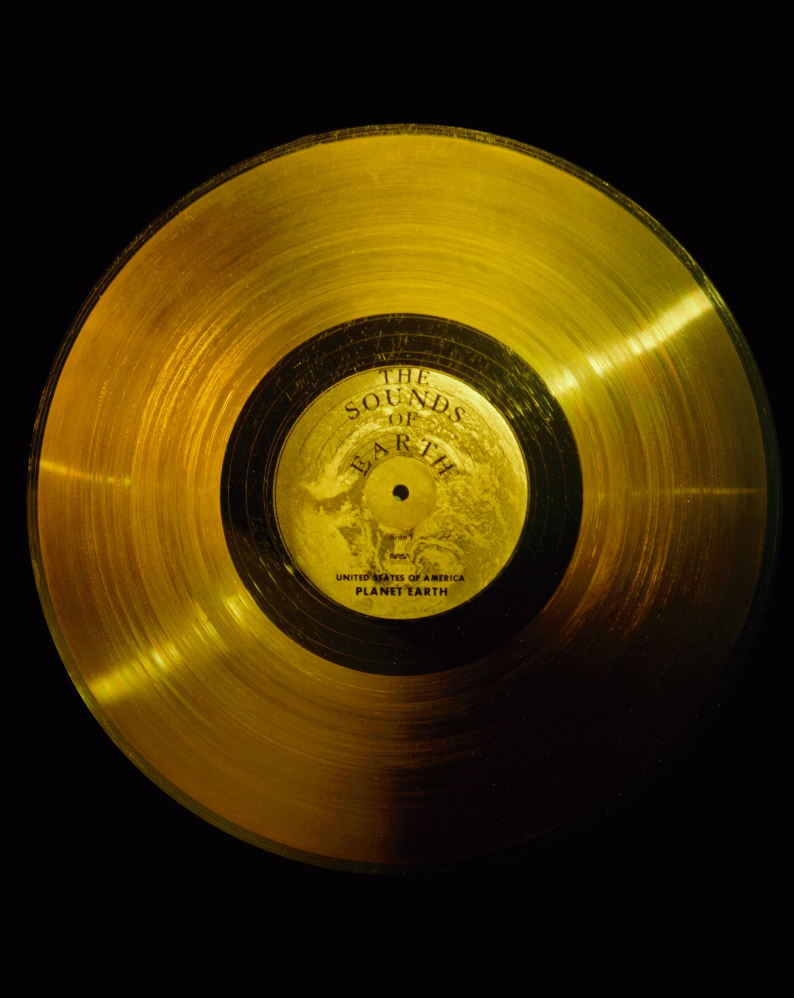
The Golden Record
Notes:
12” Gold-plated Copper disk
There are 115 images encoded in analog form
Remainder of record is in audio form designed to be played at 16-2/3 revolutions/minute
Greetings in 55 languages
Natural sounds such as surf, wind, thunder, birds, whales and other animals
90 minutes of eclectic music including Eastern and Western classics as well as a variety of ethnic music

Slide 34
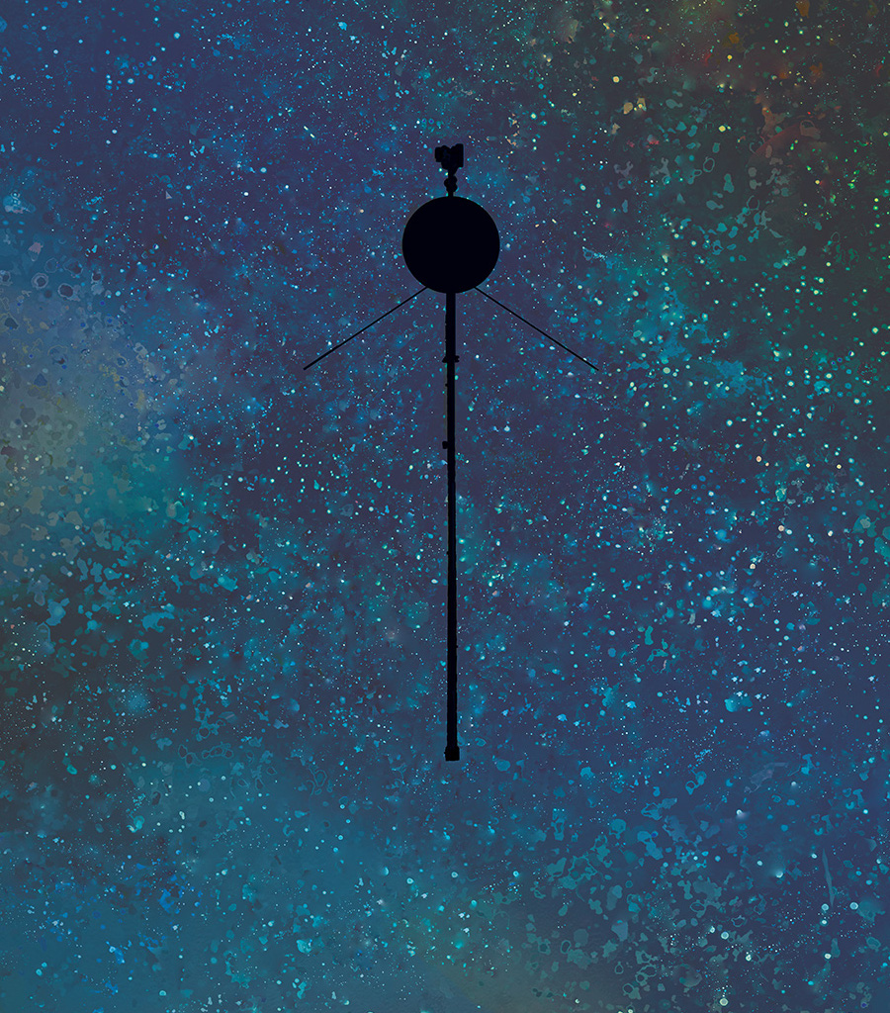
Questions???

Slide 36
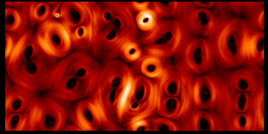
Notes:
Scientists believe the bubbles are the result of the twisting of the Sun’s magnetic field as it rotates, and then the magnetic lines are compressed and reflected at the heliopause causing the lines to break down into this froth of magnetic bubbles.

Slide 37
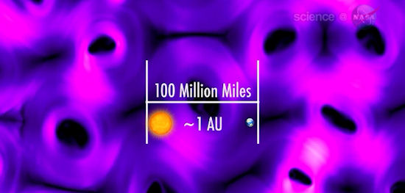
Notes:
Each bubble is large, about 100 million miles in diameter and they are constantly oscillating at ± 10 to 20 km. It takes months for Voyager to traverse even 1.
As a result the view of this part of space has been altered, but NASA was convinced Voyager was still within the heliosheath.

Slide 38
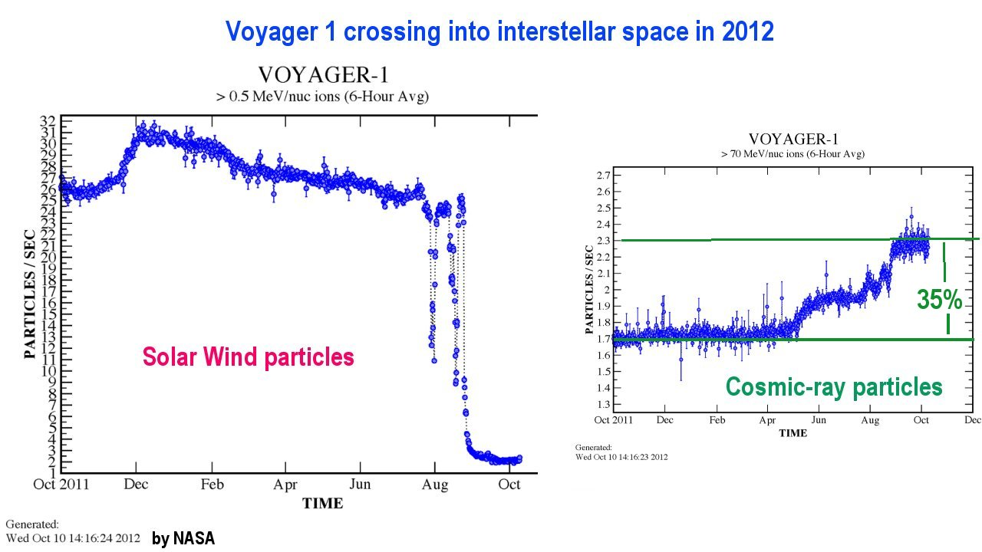
Notes:
In July and August of 2012 began seeing a shift in the concentration of Solar wind particles vs. Cosmic-rat particles
Voyager 1 was at 121 AU or about 11.2 billion miles from Earth
This was an indication that Voyager 1 was passing through the Heliopause
This was the transition from Solar space to Interstellar space

Slide 39
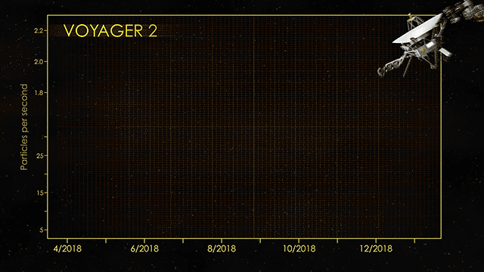
Notes:
Voyager 2 passes through the Heliopause in 2018

Slide 40
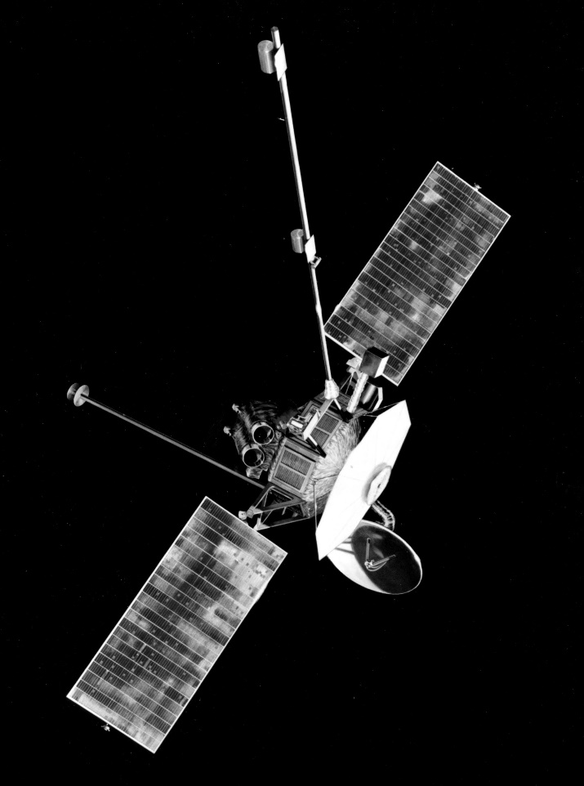
The Mariner Program
Notes:
The Picture on the left is a spacecraft from the Mariner Program, which sent probes to Mercury, Venus and Mars from 1962 to 1973.
The next mission to send probes on the Grand Tour Mariner 11 and Mariner 12.
However, Congress sent budget cuts to NASA in 1972, which doomed plans for a Grand Tour.
The mission was cut to include only flybys of Jupiter and Saturn.
The new Mariner spacecraft were of a significantly different design that took advantage of advances in technology
NASA decided to give the program a completely separate name – Voyager.
More than 10,000 trajectories were studied before two were chosen which would allow close flybys of Jupiter and its moon Io, and Saturn and its large moon, Titan.
The chosen path for Voyager 2 preserved the option to continue on to Uranus and Neptune.
The Voyager spacecraft were designed to last at least five years to fulfill their missions to Jupiter and Saturn.

Slide 41
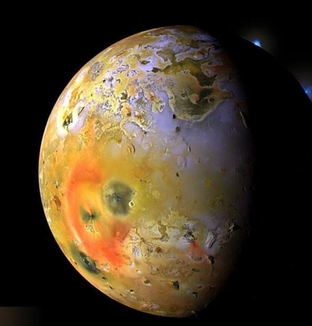
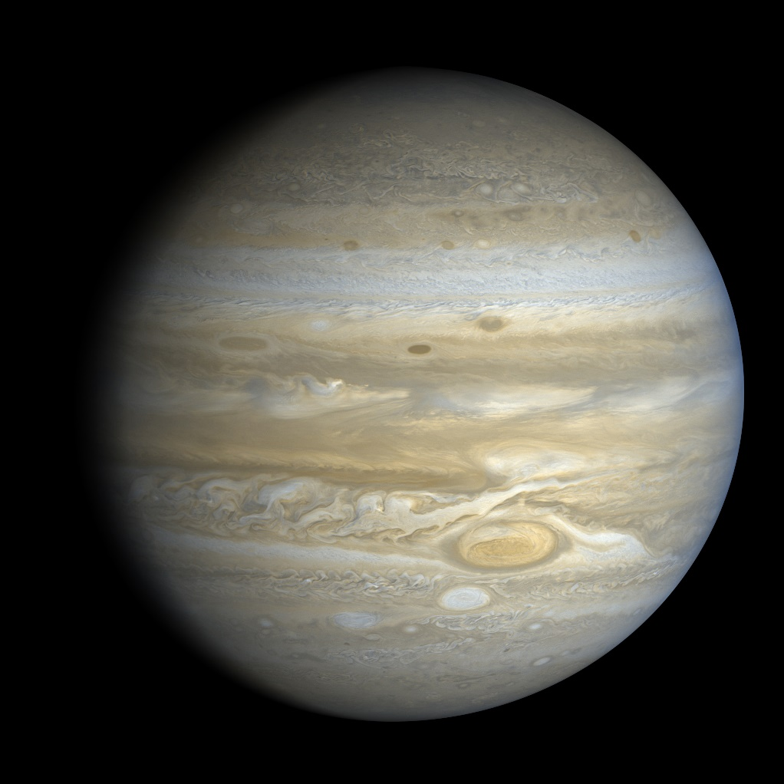
Encounter with Jupiter
Notes:
Voyager 1 encounter March 5, 1979
Voyager 2 encounter July 19, 1979
The two spacecraft took a total of 33,000 images of Jupiter and its 5 major satellites
The images taken by Voyager were clearly superior to any taken by Earth-bound telescopes
They also did a number of scientific experiments
Discovered volcanism on Io and a delicate ring system

Slide 42
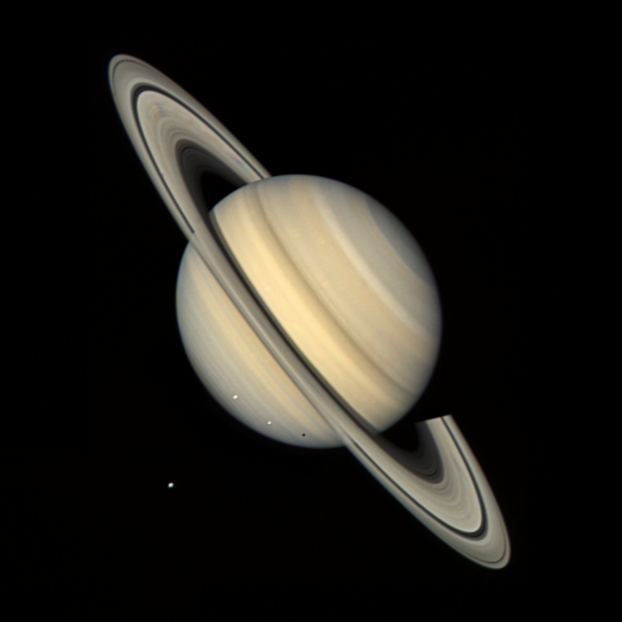
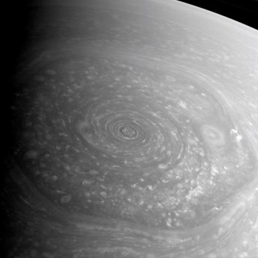
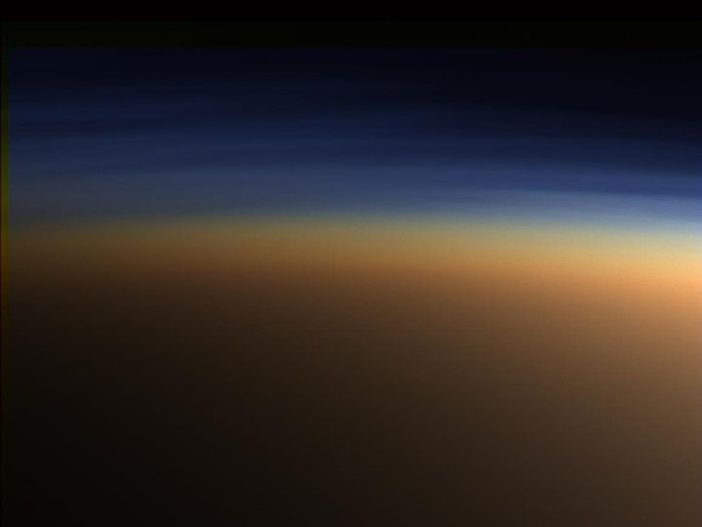
Encounter with Saturn
Notes:
Voyager 1 flew by Saturn on November 12, 1980
Voyager 2 made its closest approach on August 26, 1981
Voyager 1 made detailed studies of Saturn’s ring system
Voyager 2 studied the atmosphere of Saturn including the first image of the mysterious hexagonal cloud feature found at the north pole
Voyager 1’s altered trajectory allowed it to make a close pass of the moon Titan photographing and analyzing the moon’s atmosphere
It was found to be denser than Earth’s and composed mostly of Nitrogen

Slide 43
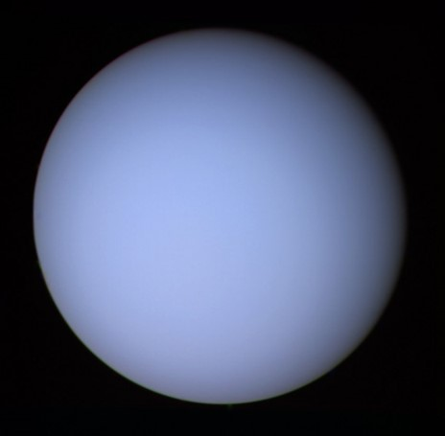
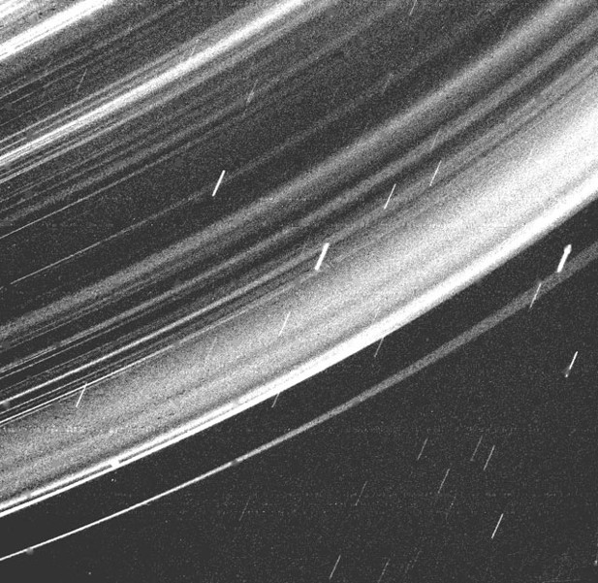
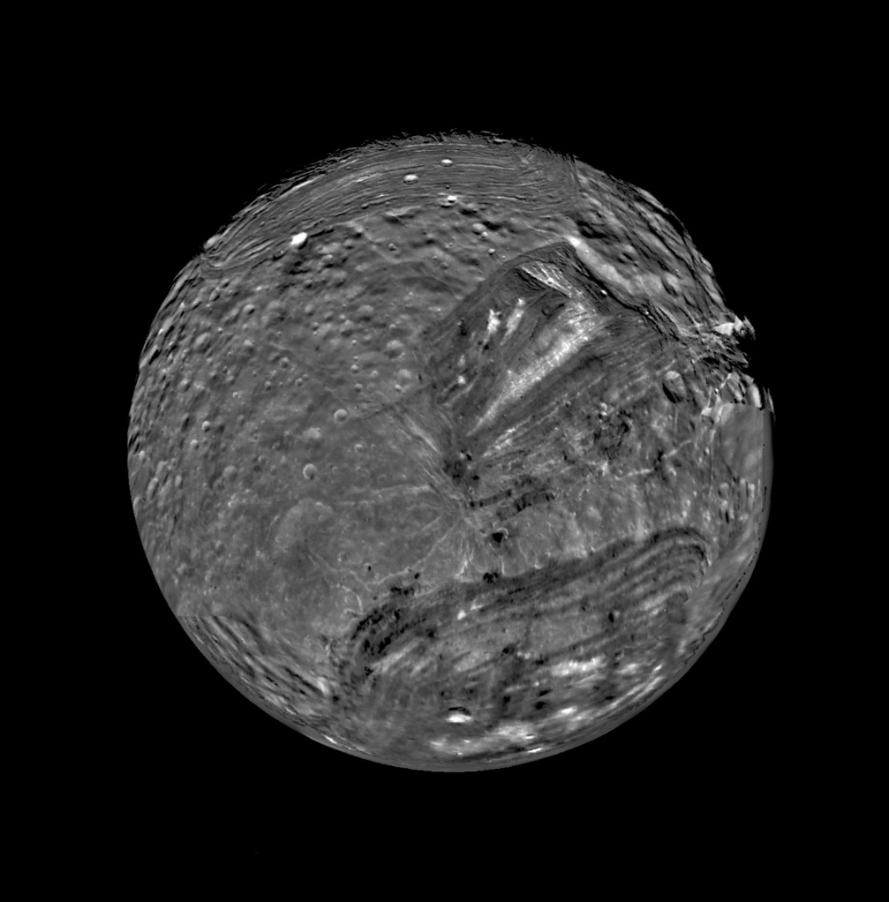
Voyager 2 Encounter with Uranus
Notes:
Voyager 2 made its closest approach to Uranus on January 24, 1986 when it came within 50,600 miles of Uranus’ cloud tops.
As expected Voyager was able to image the nine rings of Uranus and four additional ones. This image shows the rings backlit revealing the dust lanes.
Unlike Saturn the rings were found to consist of dark gray material which reflects only a few percent of the weak sunshine.
Scientists believe the delicacy of the rings and the dark material indicates the rings are much younger than Saturn’s possibly formed by a satellite torn apart by collision or tidal forces.
Miranda - About half ice and half rock, Miranda's surface has terraced layers and other features that indicate both older and younger surfaces coexist. Some of the fault canyons extend down 20 km.
Scientists have proposed two explanations for the mixing of ancient and recent surfaces. One theory is that Miranda could have been shattered and then reassembled as many as five times. Another hypothesis is that upwelling of partly melted ice created new surfaces.

Slide 44
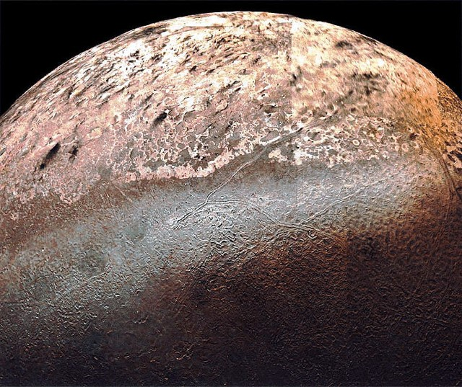
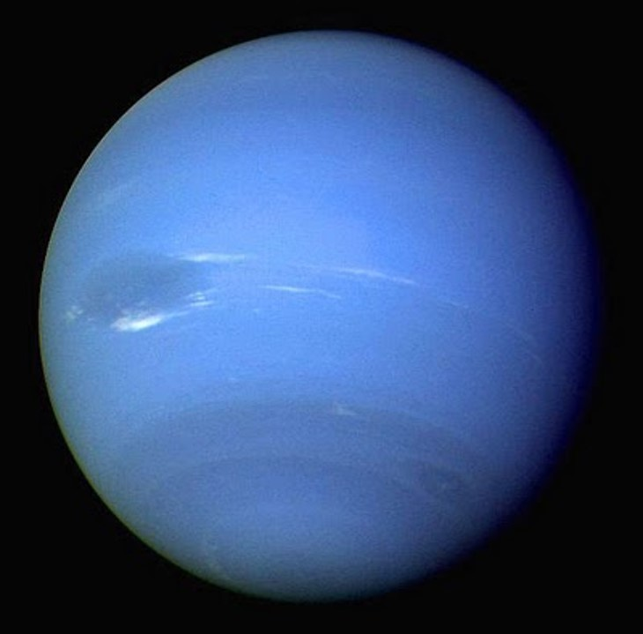
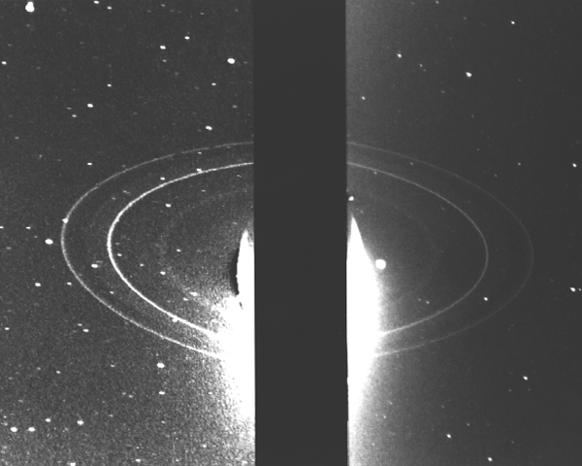
Voyager 2 Encounter with Neptune
Notes:
After receiving a gravity boost from Uranus Voyager 2 continued on to rendezvous with Neptune on August 25, 1989
Voyager 2 found the composition of Neptune’s atmosphere to be composed of hydrogen, helium and methane.
Similar in appearance to Jupiter’s Great Red Spot, the elliptical spot was roughly 13,000 km by 6,600 km or about the same size as the Earth
Neptune’s were thought to be discovered in 1981 but It was this image from Voyager 2 that truly confirmed the Neptunian ring system.
Voyager 2 flew by Triton on August 25 1989.
Despite the low light and ancient video technology by our standards Voyager managed to get great pictures of Triton
They revealed a surface described as having a cantaloupe look. Surprisingly it is nearly devoid of craters and has evidence of cryovolcanism

Slide 45
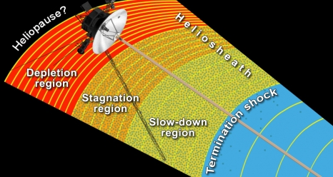
Close to the Edge

